Slide 1
Validation and Evaluation

Slide 2
Cross Validation Techniques
K-fold
Leave-p-out
Hold out

Slide 3
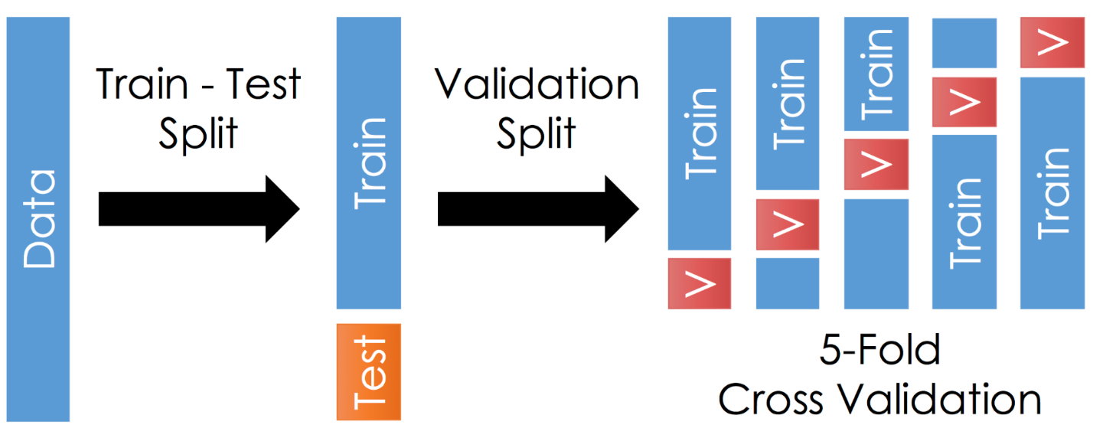
1. K-fold
Decide a value of K
e.g. K = 10 makes it 10-fold cross validation
Apply k-fold cross validation to tune model parameters
Train and Test Accuracy is averaged for K-folds

Slide 4
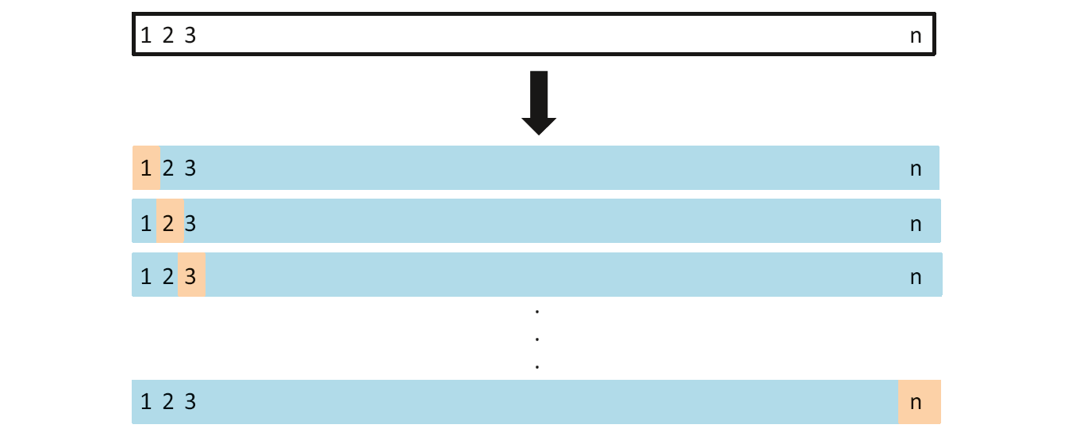
2. Leave one out (p = 1)
N-fold cross validation (where N is the total samples in data)
Special case of k-fold cross validation, having folds equal to number of data samples
Preferred when limited data available
Validation performance checked for each instance

Slide 5
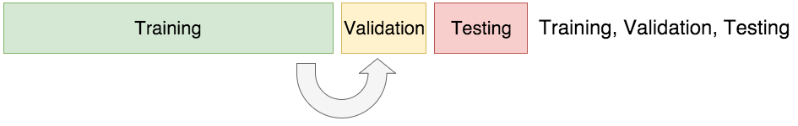
3. Hold Out
Used when sufficient training data available
No hard & fast rule about the portion for training, validation and testing
Validation data is used to tune the parameters of the model

